Slide 1
Music Recommender System
A Project By:
Aditya Didwania

Slide 2
ABSTRACT
Machine learning (ML) equips computers to learn and interpret without being explicitly programmed to do so. Here, as the "computers", also referred as the "models", are exposed to sets of new data, they adapt independently and learn from earlier computations to interpret available data and identify hidden patterns. This involves data analysis and automation of analytical model-building using numerous ML algorithms. ML enables computers and computing machines to search for and identify hidden insights, without being programmed for where to look for, when exposed to new data sets.
To get the maximum value from big data, businesses must know exactly how to pair the right algorithm with a particular tool or process and build machine learning models based on iterative learning processes.

Slide 3
INTRODUCTION
The number of songs available exceeds the listening capacity of an individual in their lifetime. It is tedious job for an individual to sometimes to choose from millions of songs and there is also a good chance missing out on songs which could have been the favourites.
Music service providers like Spotify need an efficient way to manage songs and help their customers to discover music by giving a quality recommendation. For building this recommendation system, they deploy machine learning algorithms to process data from a million sources and present the listener with the most relevant songs.
The underlying goal of the recommendation system is to personalize content and identify relevant data for our audiences. These contents can be articles, movies, games, etc.

Slide 4
APPROACH
The Problem Statement
A company is launching a new music app which recommends music to the user based on the user’s previous listening history. The system analyses the user’s listening history and recommends music which the user will like by suggesting music pertaining to the same genre or similar artist.
What is Collaborative Filtering?
Collaborative filtering, also referred to as social filtering, filters information by using the recommendations of other people. It is based on the idea that people who agreed in their evaluation of certain items in the past are likely to agree again in the future.
A person who wants to see a movie for example, might ask for recommendations from friends. The recommendations of some friends who have similar interests are trusted more than recommendations from others. This information is used in the decision on which music to suggest.

Slide 5
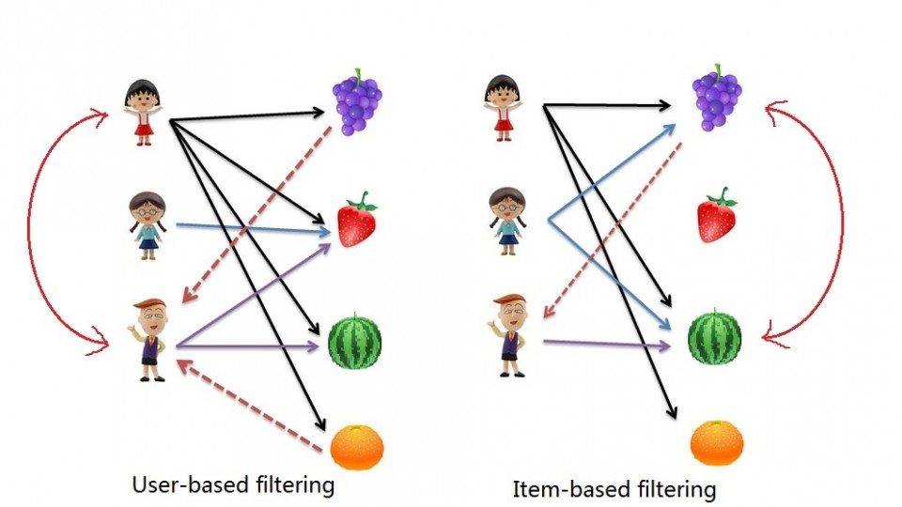
User-based Collaborative Filtering
Find users who have
a similar taste of products
as the current user.
Similarity is based upon
similarity in users’
purchasing behaviour.
“User x is similar to user y
because both purchased
items A, B and C.”

Slide 6
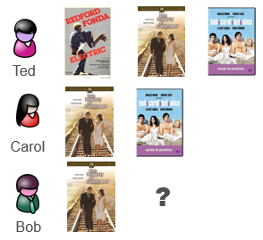
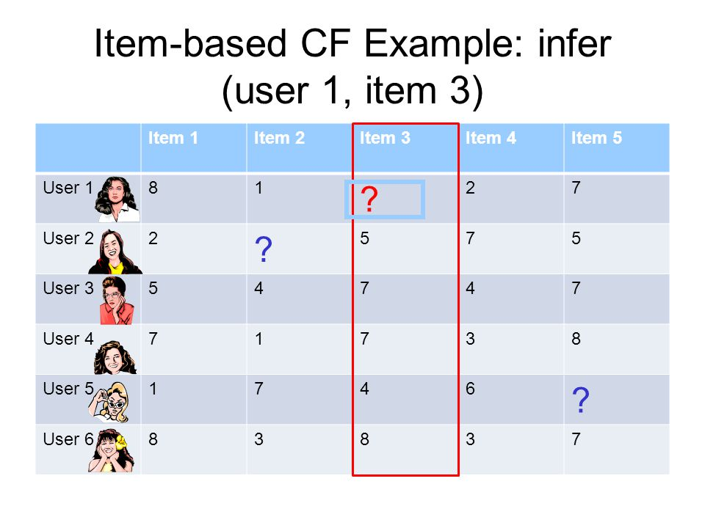
User-based Collaborative Filtering
History Matrix
Co-occurrence matrix
B
A
C
A
C
A

Slide 7
How does it work?
A recommender system works by mapping the distance (ie the "similarity") between points (ie users) in our dataset. Three popular metrics include:
~ The Jaccard similarity is a good choice for implicit item feedback (ie binary feedback such as like/dislike or played/not played).
~ The Cosine similarity is good for comparing the ratings of items, but does not consider the differences in mean and variance of the items.
~ The Pearson Correlation similarity also compares the ratings of items and effects of mean and variance have been removed.

Slide 8
Implementing the Nearest Neighbour Model
Reshaping the Data
For K-Nearest Neighbors, we want the data to be in an m x n array, where m is the number of item and n is the number of users. To reshape the dataframe, we’ll pivot the dataframe to the wide format with song id as rows and users as columns. Finally, we transform the values of the dataframe into a spicy sparse matrix for more efficient calculations.
wide_artist_data = usa_data.pivot(index = ‘song id', columns = 'users', values='plays').fillna(0)
wide_artist_data_sparse = csr_matrix(wide_artist_data.values)

Slide 9
FITTING THE MODEL
To fit a particular model, we’ll initialize the Nearest Neighbors class as model_knn and fit our sparse matrix to the instance. By specifying the metric = cosine, the model will measure similarity between artist vectors by using cosine similarity.
from sklearn.neighbors import NearestNeighbors
model_knn = NearestNeighbors(metric = 'cosine', algorithm = 'brute')
model_knn.fit(wide_artist_data_sparse)

Slide 10
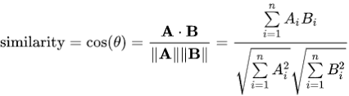

User-Based Collaborative Filtering
Firstly, we will have to predict the rating that user 3 will give to item 4. In user-based CF, we will find say k=3 users who are most similar to user 3. Commonly used similarity measures are cosine, Pearson, Euclidean etc. We will use cosine similarity here which is defined as below:
And, pearson correlation, defined as:

Slide 11
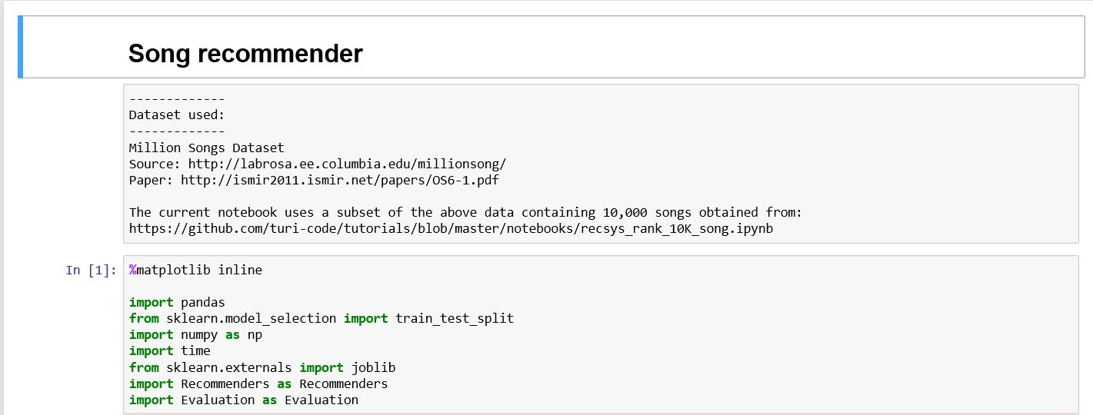
Step 1:Importing the Libraries

Slide 12
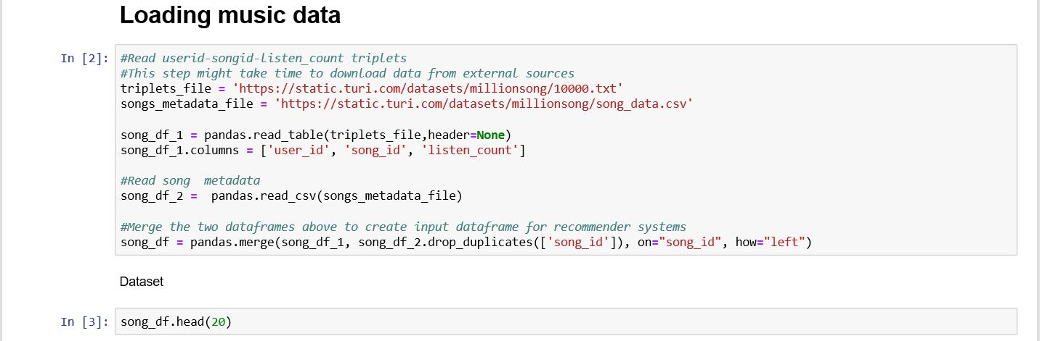
Step 2: Loading the Music Data

Slide 13
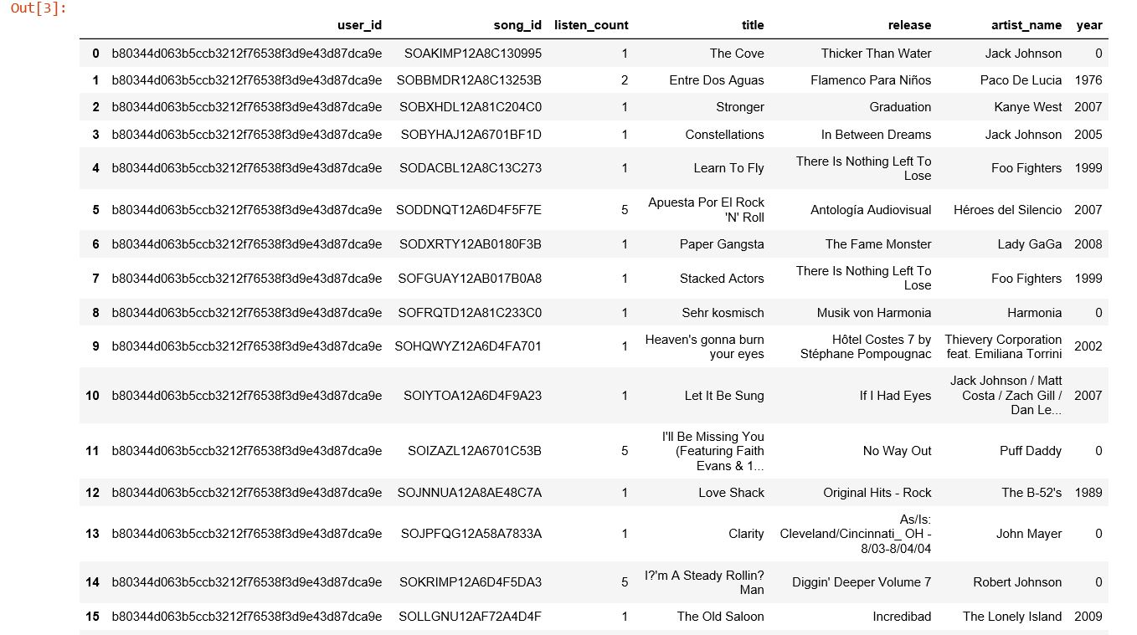

Slide 14
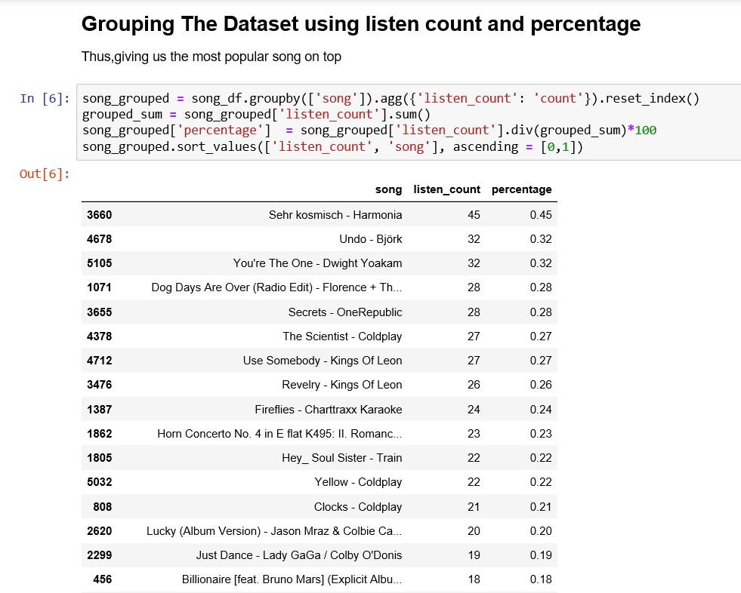
Step 3: Cleaning The Data by taking only relevant attributes

Slide 15
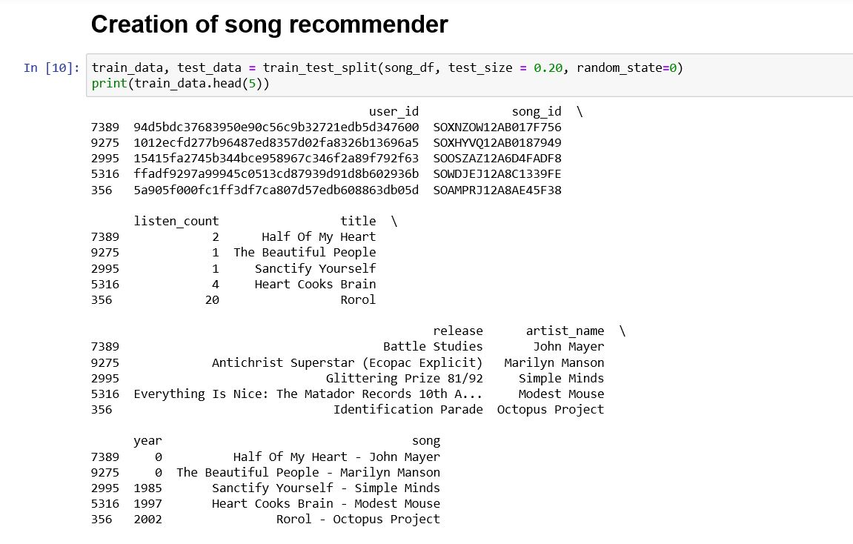
Step 4: Creating Test Data

Slide 16
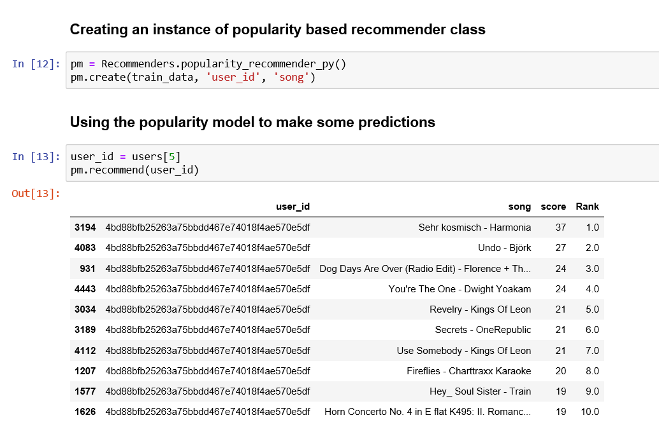
Step 5: Recommendation of song on the basis of popularity only

Slide 17
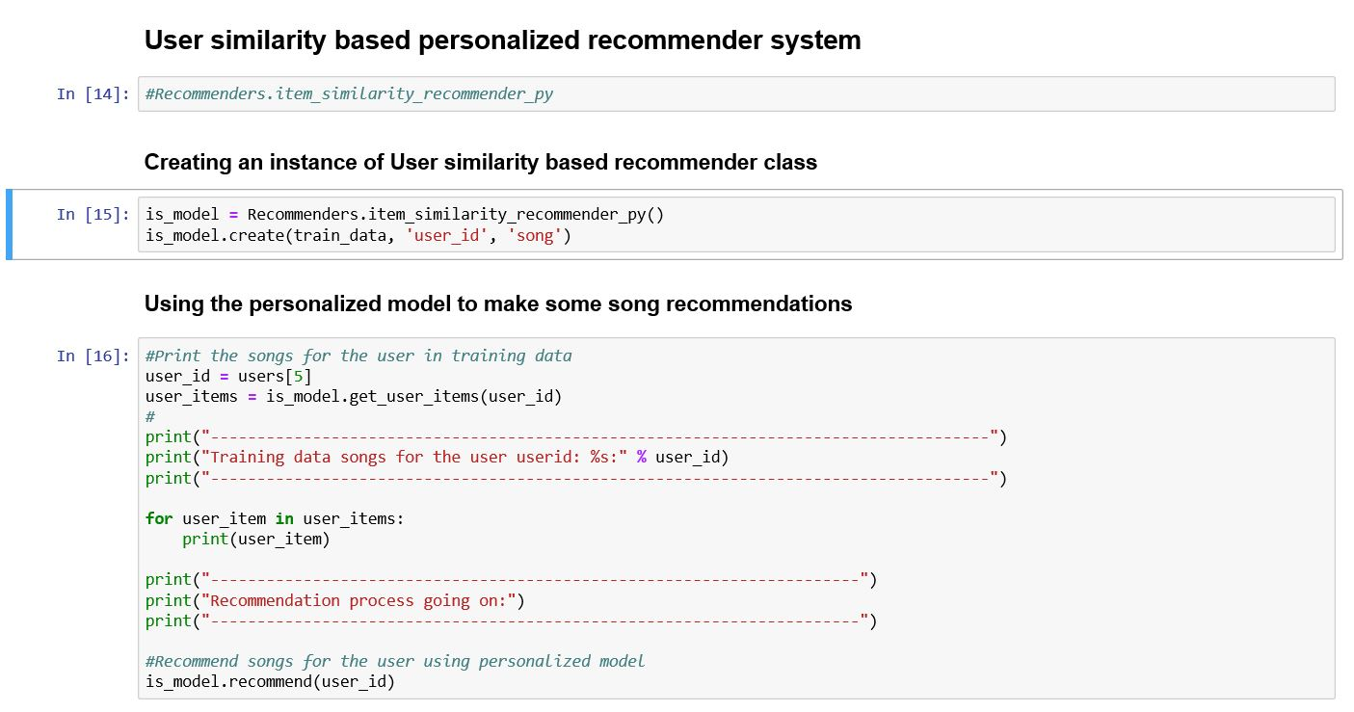
Step 6: Recommending Song by using User Based Collaborative Filtering

Slide 18
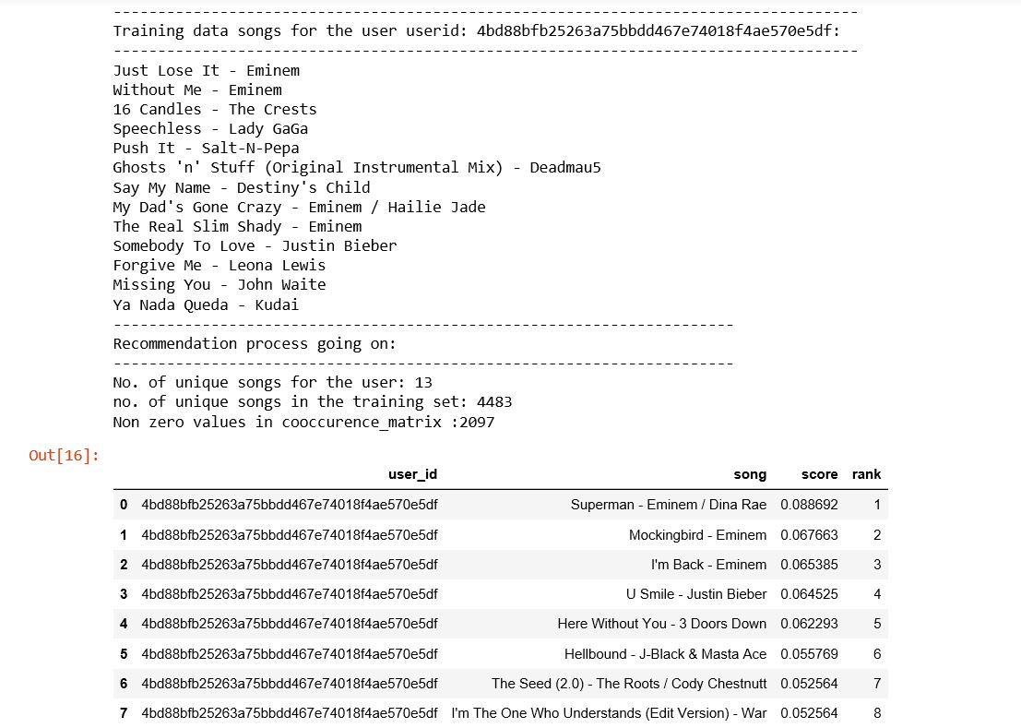

Slide 19
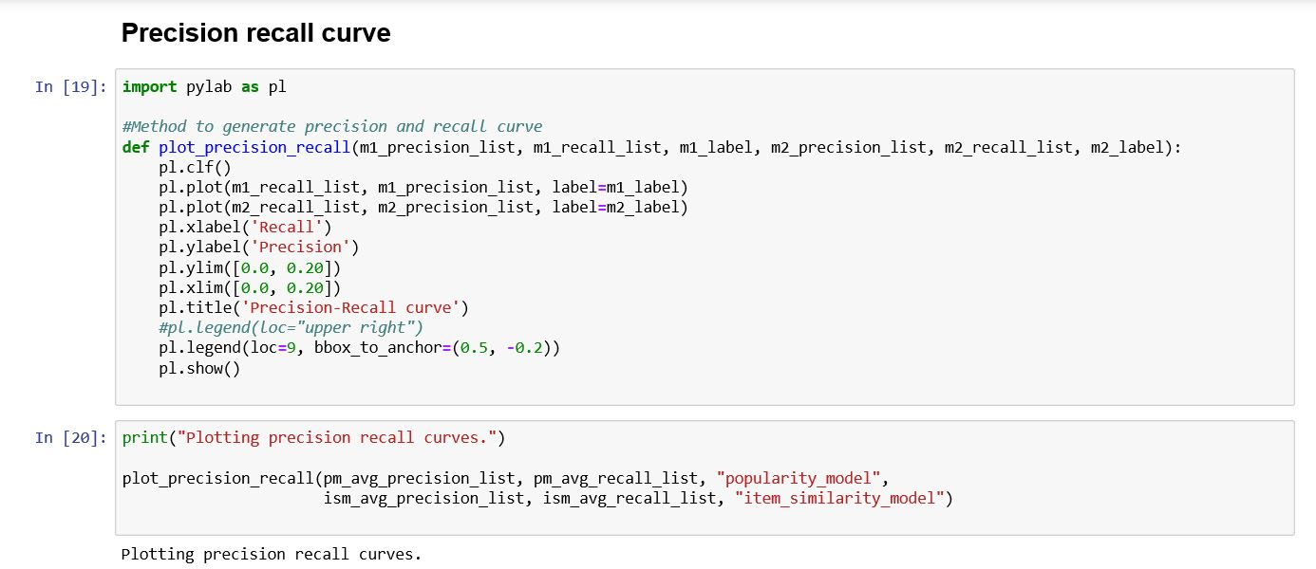
Step 7: Create a Precision Recall Curve to Check Precision and Compare both models

Slide 20
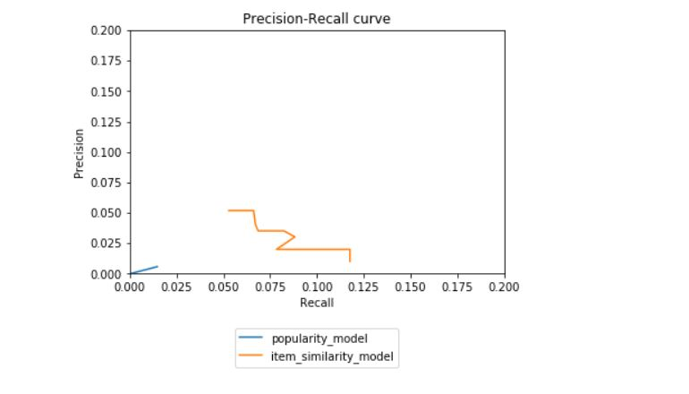

Slide 21
CONCLUSION
The implementation of this real-time project finds its applications in many recommender engines. The reliability and robustness of collaborative filtering can easily be seen over content-based filtering approach for this model
We also realize that building a recommender system is not a trivial task. The fact that its large scale dataset makes it difficult in many aspects. Firstly, recommending 10 correct songs out of 1 million for different users is not an easy task to get a high precision.
Secondly, the metadata includes huge information and when exploring it, it is difficult to extract relevant features for song. Thirdly, technically speaking, processing such a huge dataset is memory and CPU intensive. All these difficulties due to the data and to the system itself make it more challenging and also more applicable to dynamic real-world problems.

Slide 22
FUTURE ENHANCEMENTS
• Run the algorithms on a distributed system, like Hadoop or Condor, to parallelize the computation, decrease the runtime and leverage distributed memory to run the complete MSD.
• Combine different methods and learn the weightage for each method according to the dataset
• Automatically generate relevant features
• Develop more recommendation algorithms based on different data (e.g. the how the user is feeling, social recommendation, etc)

Slide 23
THANK YOU.

